Slide 1
Apache Pig Tutorial
Pranamesh Chakraborty
Resources: CPRE-419 course in ISU (Large Scale Data Analysis)

Slide 2
Apache Pig
Framework for large scale data processing, at a higher level of abstraction than MapReduce.
Writes programs faster than MapReduce for processing large datasets

Slide 3
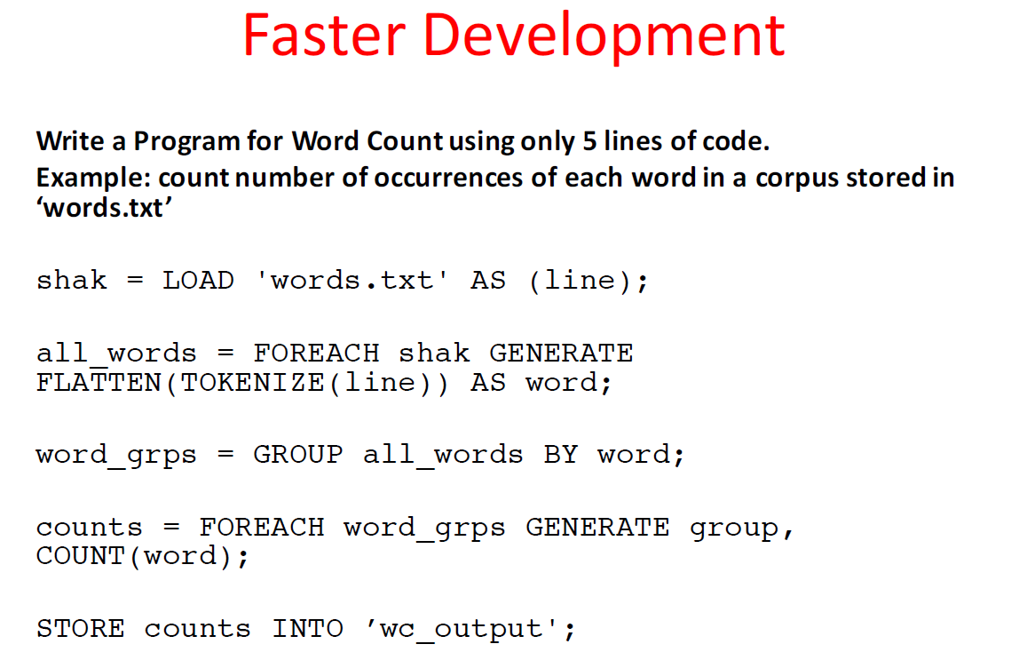
Apache Pig

Slide 4
HDFS Login
Follow instructions given in Github

Slide 5
Common hdfs commands
Starts with hdfs dfs -….
or hadoop fs -….
See the contents of a folder:
hdfs dfs –ls <location>
Examples:
hdfs dfs –ls
hdfs dfs –ls inrix

Slide 6
Common hdfs commands
Make a new directory in hdfs:
hdfs dfs –mkdir <hdfs directory location>
hdfs dfs –mkdir pranamesh
See the tail of a file in hdfs:
hdfs dfs –tail <hdfs file location>
hdfs dfs –tail inrix/2-2-2017.csv
See the top of a file in hdfs:
hdfs dfs –cat <hdfs file name>|head -10
hdfs dfs –cat inrix/2-2-2017.csv|head -10

Slide 7
Common hdfs commands
Copy to Local machine from HDFS
hdfs dfs –copyToLocal <local machine location> <location in HDFS>
Then copy the required file from the local machine to your machine via WinScp
hdfs dfs –copyToLocal inrix/sample.csv pranamesh

Slide 8
Common hdfs commands
Copy from Local machine to HDFS
First copy the required file to the local machine via WinScp
hdfs dfs –copyFromLocal <local machine location> <location in HDFS>
hdfs dfs –copyFromLocal pranamesh/sample.csv pranamesh

Slide 9
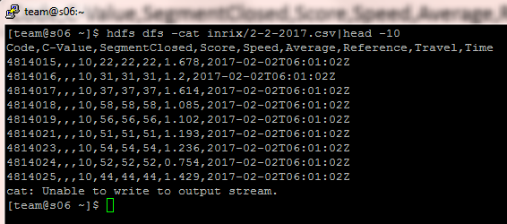
Pig Script
A sample script on INRIX XD Data
Inrix XD data Schema:
Code,C-Value,SegmentClosed,Score,Speed,Average,Reference,Traveltime,Time

Slide 10
Pig Script
Inrix XD data Schema:
Code,C-Value,SegmentClosed,Score,Speed,Average,Reference,Traveltime,Time
Problem: Count the number of occurrences of confidence score = 30 for any 10 segments with the sample Inrix XD data, and output them to a file

Slide 11
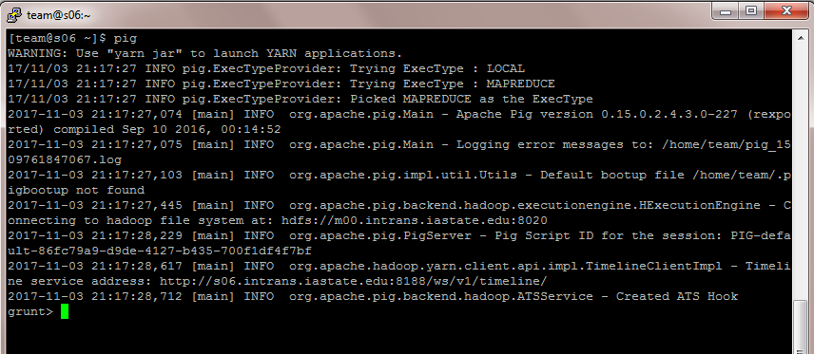
Pig Grunt Shell
Type “pig” in your putty terminal. The grunt shell is open.

Slide 12
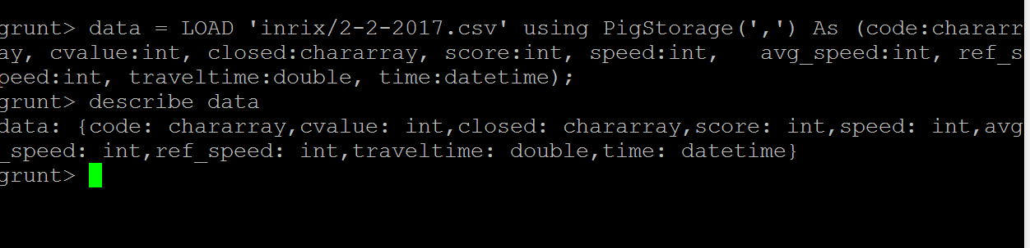
Pig Grunt Shell
Type each of the commands given in Github pig script in the grunt shell
Script location: https://github.com/pranamesh/Python-workshop-TSA/blob/master/Apache-Pig/test_script.pig

Slide 13
Pig Script
Run the script:
pig <script location in Local machine>
pig Pranamesh/test-script.pig

Slide 14
Apache Pig
Resources:
Reference Manual:
https://pig.apache.org/docs/r0.7.0/piglatin_ref2.html
Built-in functions
https://pig.apache.org/docs/r0.11.1/func.html

